Slide 1

Predicting Heart Failure using Machine Learning(binary classification problems)
Frank Williams
Adrian Torres
Paige Madison

Slide 2
Update 1
Frank Williams
Adrian Torres
Paige Madison

Slide 3
Project Summary
Accomplishments(i.e., Completed Tasks): Defined DS question Can we predict heart failure with the variables in the dataset? Developed working model Logistic Regression model | Plans for next update: Split the visualization tasks Answer secondary questions using visuals
Working Well: Ability to load dataset Accuracy metric with test model was assessed | Issues: We may have an excessive number of columns and discerning which are important may be in issue.

Slide 4
Attendance Records
Updates:
On 02/17/2024(Duration: 30min)-
We discussed the dataset that we could use, the overall data science question we want to answer, the type of data we want to predict, and the put together a timeline to finish the project.
On 02/19/2024 (Duration: 40min)-
Explored data set further – examined variables and defined questions we want to answer. Shared the Trello board and confirmed each member has access. Set another meeting for next Sunday 3/25/24.
Attendance for Meeting 1:
All were in attendance
Attendance for Meeting 2:
All were in attendance

Slide 5
Data Origin
The survey data comes from the CDC’s Behavioral Risk Factor Surveillance System and was collected in 2023 and was collected from all 50 states.
The data does not have any Na values, but we did double check.

Slide 6
Steps to Complete
1. Define the Problem
2. Gather Data
3. Data Preprocessing
4. Exploratory Data Analysis (EDA)
5. Feature Selection/Extraction
6. Model Selection
7. Model Training
8. Model Evaluation
9. Iterate and Improve
10. Documentation and Communication

Slide 7
Secondary Questions for Dataset
What are the leading variables that correlate with candidates who have heart attack?
S
State, Sex, General Health, PhysicalHealthDays, MentalHealthDays, LastCheckupTime, Physical activities
Sleephours, RemovedTeetth, HadAngina, HadStroke, HadAsthma, HadSkinCancer, HadCOPD
Of the numeric variables in what range do we start to seeing candidates who do have heart attack?
For non-numeric variables what character strings appearing the most often with candidates who do have heart disease?
What are the least common variables that candidates with heart disease have?
What age do we start seeing heart disease more common among candidates?
At what age do we see heart disease become more common for males and females. Does chest pain correlate with heart disease?
Are there any differences in patients that check ups within a year versus those that get check ups past the 5-year mark?
Does race play a role in the frequency of heart attacks? If so, at what age does race play a role?
The category of White Only to have the most heart attacks out of all the races in the data set.

Slide 8
Update 2
Frank Williams
Adrian Torres
Paige Madison

Slide 9
Project Summary Update-2
Accomplishments(i.e., Completed Tasks): Visualizations Completed All variables explored Developed working model Logistic Regression model Lasso Regularization model Feature Extraction and Selection Model training and evaluation | Plans for next update: Exploring alternates to the logistic regression model for the prediction of binary text variables
Working Well: Accuracy metric with test model was assessed Github implementation was successful R-code running is successful | Issues: Assessing the relevancy of different X variables and their impact has become complicate due to the amount of X variables

Slide 10
Current Tasks to Focus on
Assessing normality and linearity
Assessing prevalence of “Yes” to “No”.
Exploring all X relationships in the form of visuals
Training the model effectively and evaluating it’s accuracy metric
Exploring other models

Slide 11
Steps in ML Project
Read in Data and structure
Got the frequency count of the general health metric.
Selected specific columns for the model and got the summary of the integer variables
Split data into a training and test set then trained and evaluated the model

Slide 12
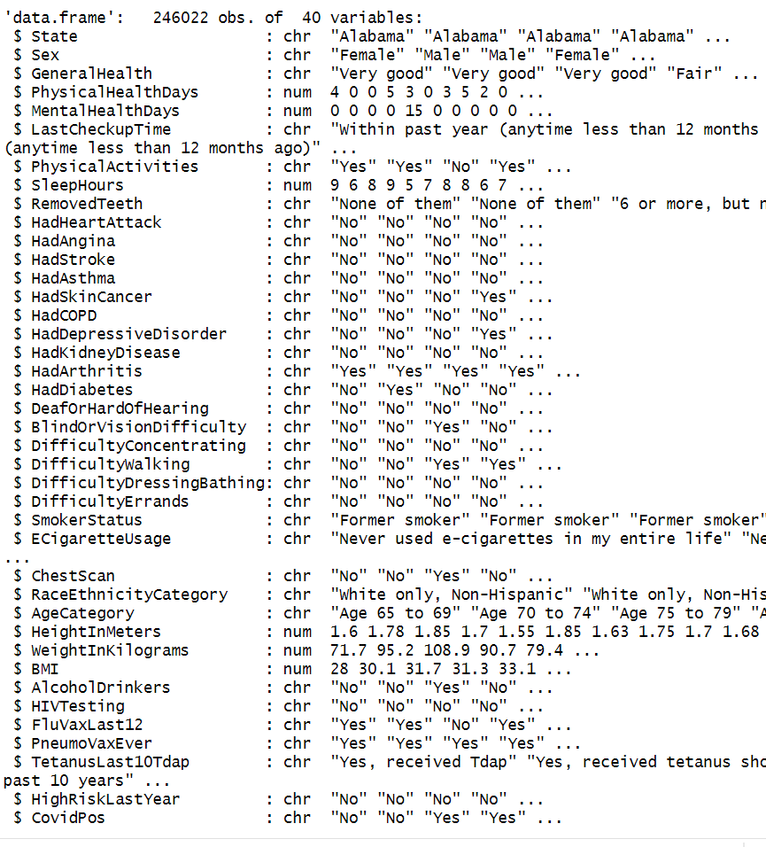
Data Structure
[1] 246022 37
Length of cat_cols: 31
Length of num_cols: 6
Length of dbl_cols: 6
Total number of columns in data_train: 38

Slide 13

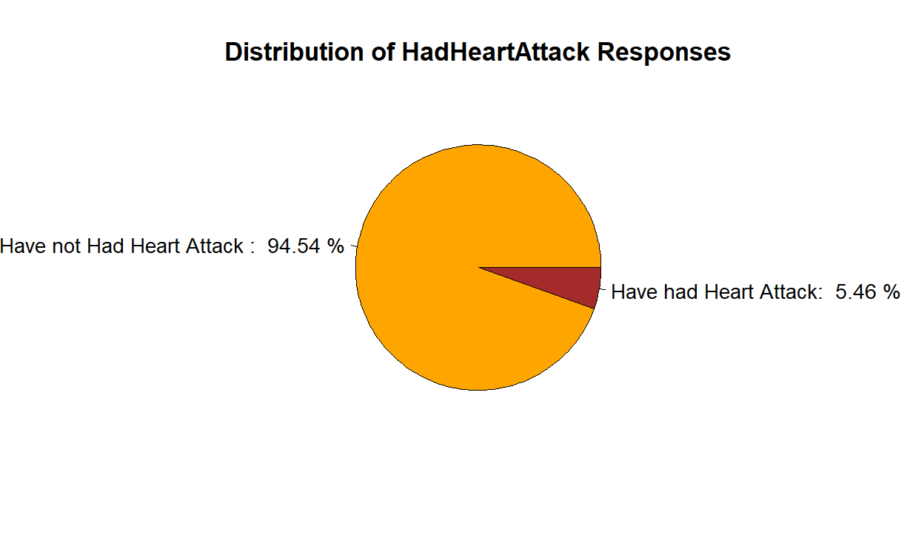
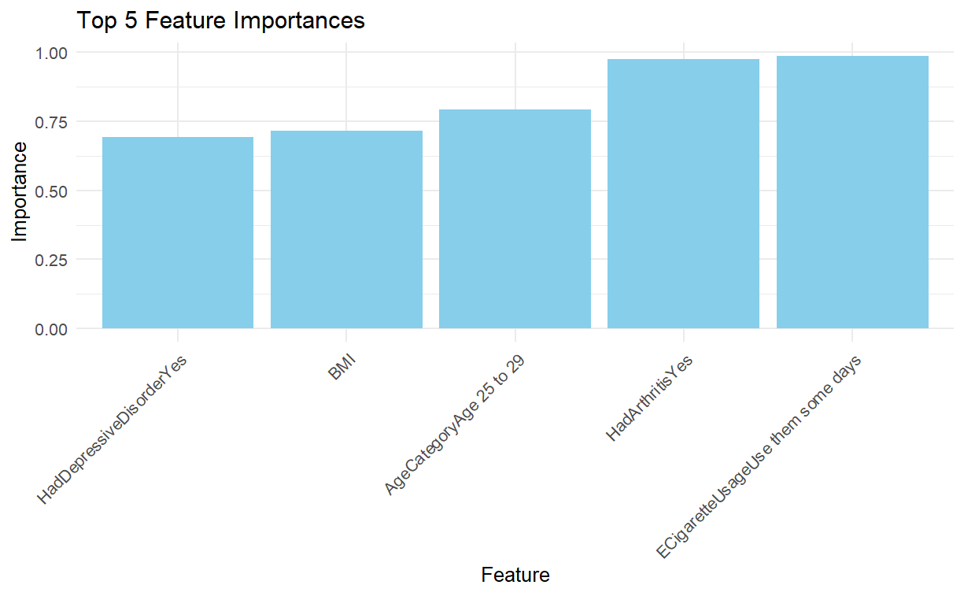
Logistic Model Creation and Output
As can seen below, a patient who have had arthritis and used E-cigarettes experienced heart attacks more frequently.

Slide 14
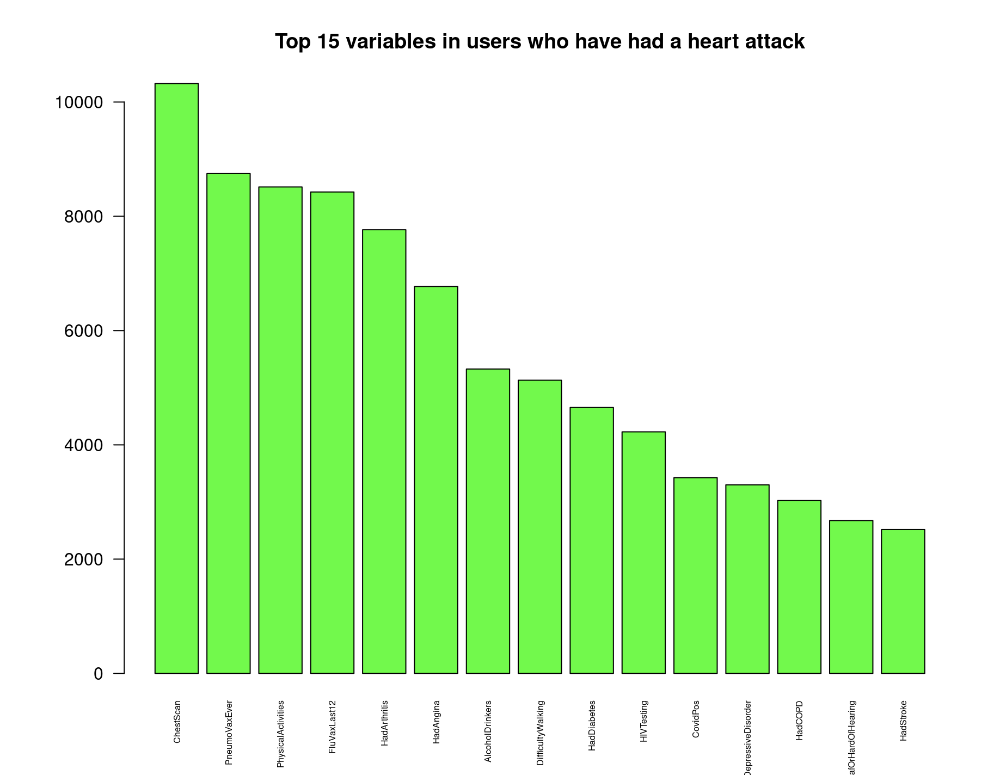
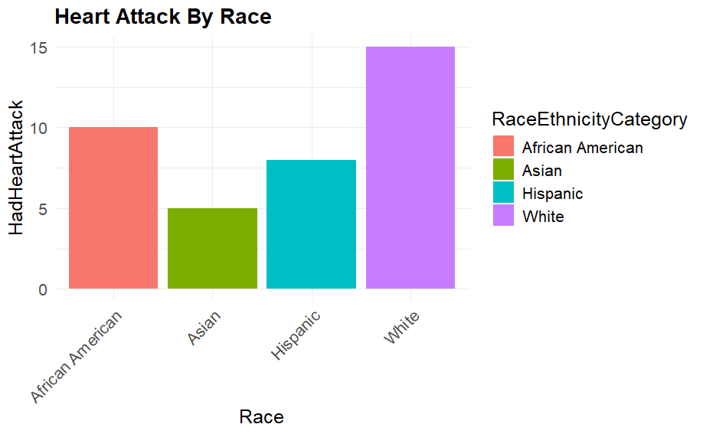
Logistic Model Creation and Output
Those who had the Pneumonia vaccine and had regular chest scans also experienced more heart attacks than other variables. You can also see that the White category has had the most heart attacks reported as well.

Slide 15
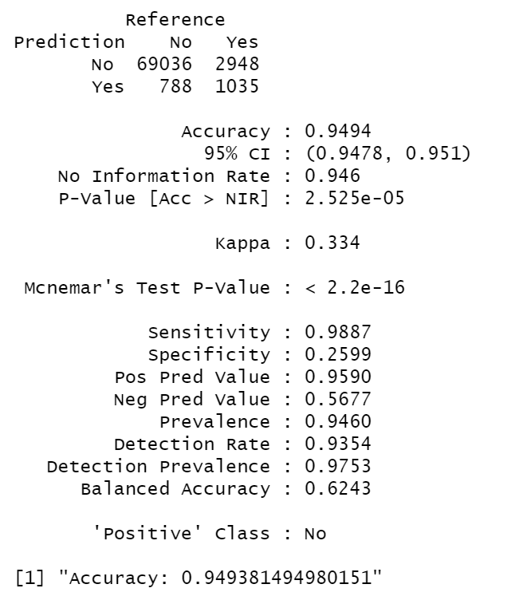
Logistic Model Creation and Output
# Model training# Fit logistic regression model
model <- glm(HadHeartAttack ~ ., data = train_data, family = binomial)
As can be seen in our output, we achieved an accuracy score of 94.94%.

Slide 16
Attendance Records
Attendance for all meetings:
Frank Williams
Adrian Torres
Paige Madison
On 03/03/2024(Duration: 1hr)- The group set deadlines for visuals and assigned new tasks to complete the final steps of the ML project.
On 03/07/2024(Duration: 1hr)- The group cleaned up code and visuals for update 2.

Slide 17
Update 3
Frank Williams
Adrian Torres
Paige Madison

Slide 18
Project Summary
Accomplishments(i.e., Completed Tasks): Developed 3 main questions Tested two models to predict heart attacks Refined the appearance of all graphs Organized and cleaned up code | Plans for next update: Finish the paper and final PowerPoint
Working Well: Running the code Pulling from GitHub Using Trello | Issues: No issues

Slide 19
Main Questions After Exploratory Analysis
Can we predict heart attacks?
Which variables are the most important for predicting heart attacks?
Are non-biological ailments like depression important for predicting heart attacks?

Slide 20
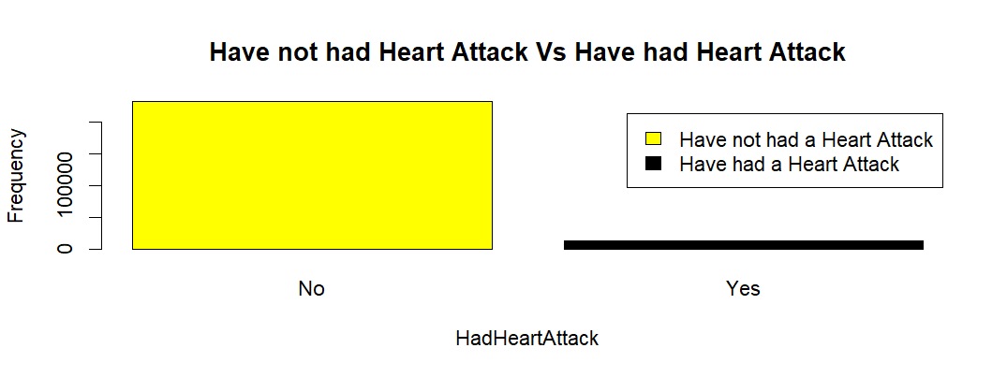
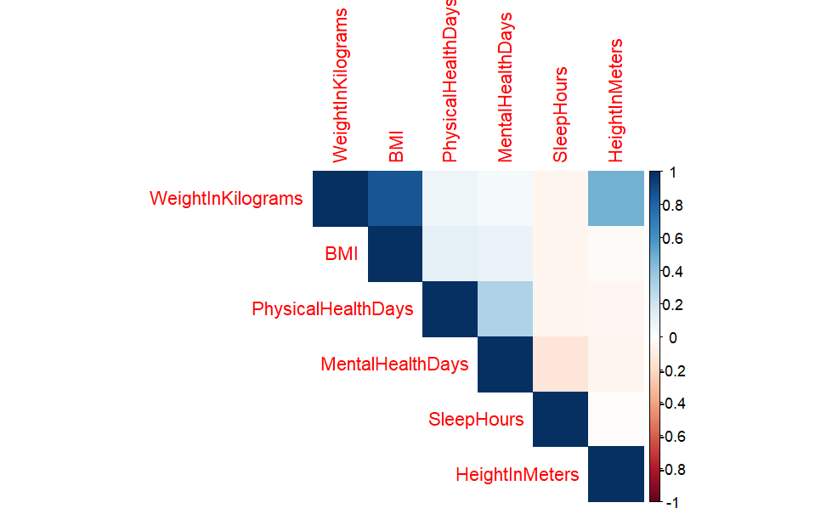
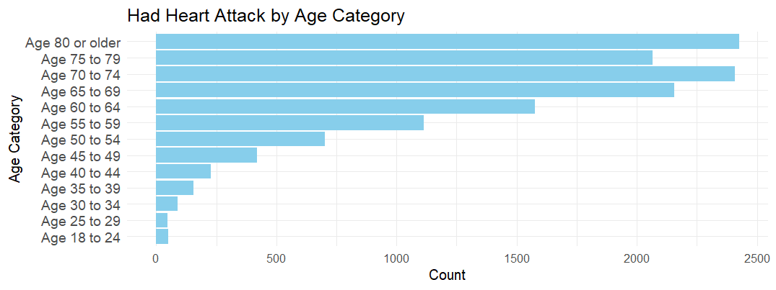
Refined Graphs

Slide 21
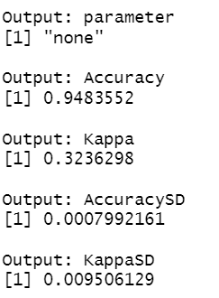
Model Outputs
As can be seen in the pictures of the model outputs, the accuracy metrics are very similar, but the K-fold version of the logistic regression model is slightly better.
K-Fold Logistic Regression Model
Logistic Regression Model

Slide 22
Attendance Records
Attendance for all meetings:
Frank Williams
Adrian Torres
Paige Madison
On 03/10/2024(Duration: 1hr)- Narrowed down paper breakdown and the three main questions we have evidence for.

